Slide 1
ROCKBUSTER stealth llc data analyst
Magda Merino​

Slide 2


OVERVIEW
Rockbuster Stealth LLC is a movie rental company that was once very famous with stores all over the world.
There are now new movie streaming platforms like Netflix and Amazon Prime, which the Rockbuster Stealth management team plans to use a movie licensing strategy to launch a rental service to stay competitive in the market.

Slide 3
QUESTIONS
Which of Rockbuster’s Genres are most profitable?
Which movies contributed the most revenue?
1
Which countries generate the most revenue?
What are the top 10 countries with the most customers?
​Who are the Rockbuster’s top 5 highest spending Customers?
4
2
5
3

Slide 4
DATA
Avg Cost to replace:
Year:
2006
$19.98
Minimum Rental rate:
Maximum Duration:
Rating:
PG-13
99₵
7 days

Slide 5
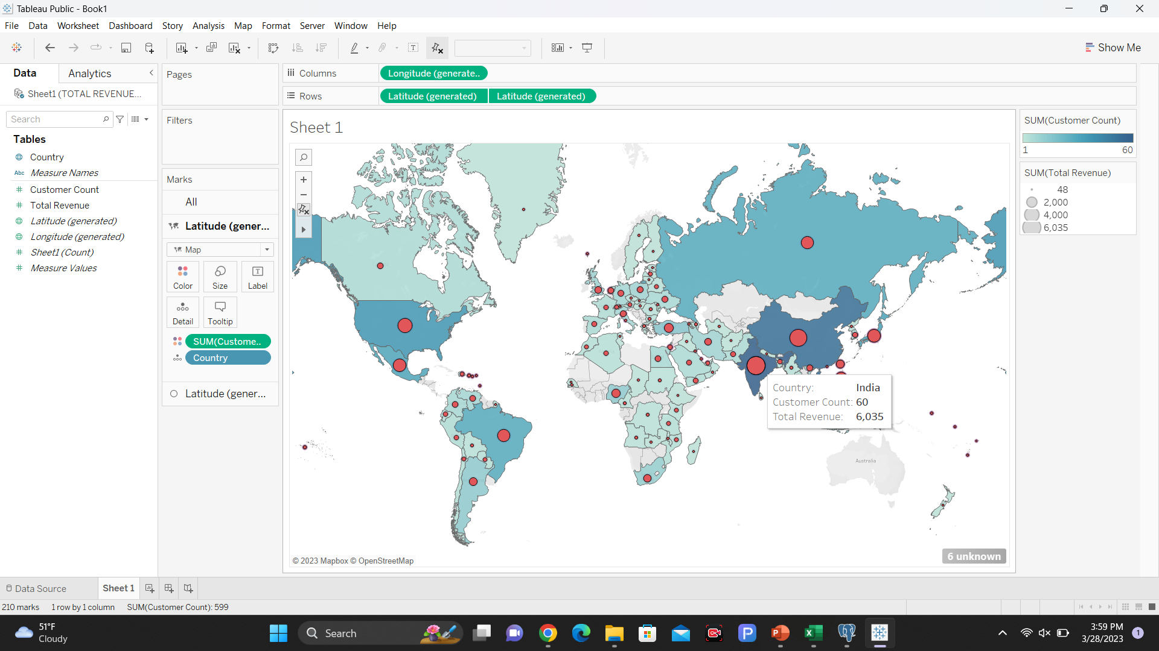
countries that generated most revenue
INDIA
CHINA
UNITED STATES
JAPAN
MEXICO
BRAZIL
RUSSIAN FEDERATION
PHILIPPINES
TURKEY
INDONESIA

Slide 6
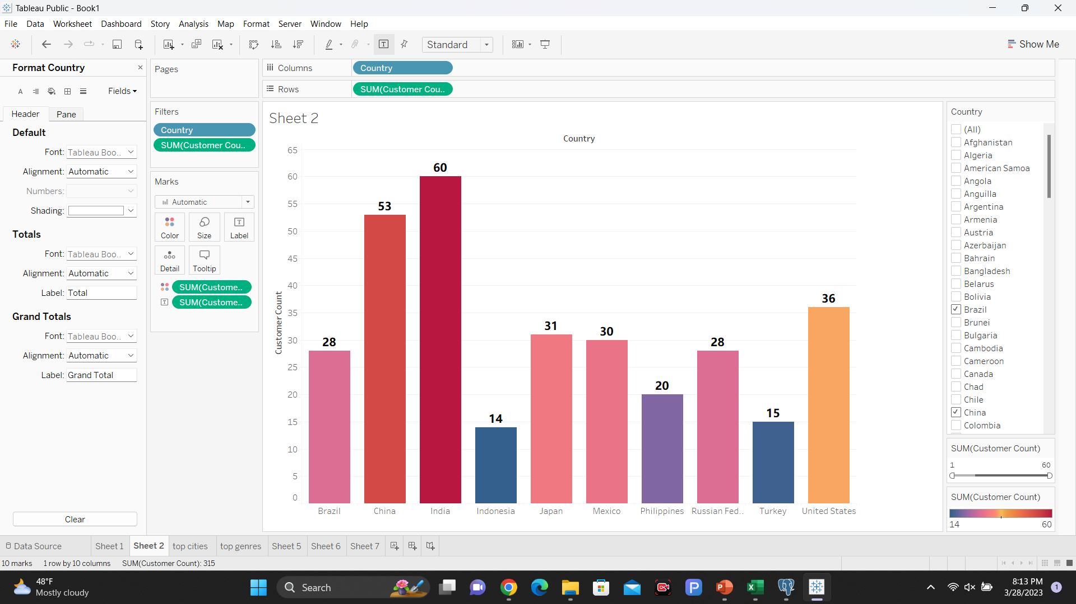
What are the top 10 countries with the most customers?
According to this graph, India and China are the countries with the most customers and, therefore, they should focus more on these markets.
BRAZIL
CHINA
INDIA
JAPAN
MEXICO
PHILIPPINES
RF
TURKEY
USA
INDONESIA

Slide 7
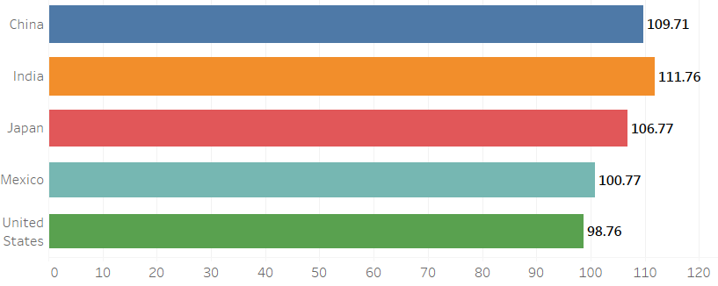
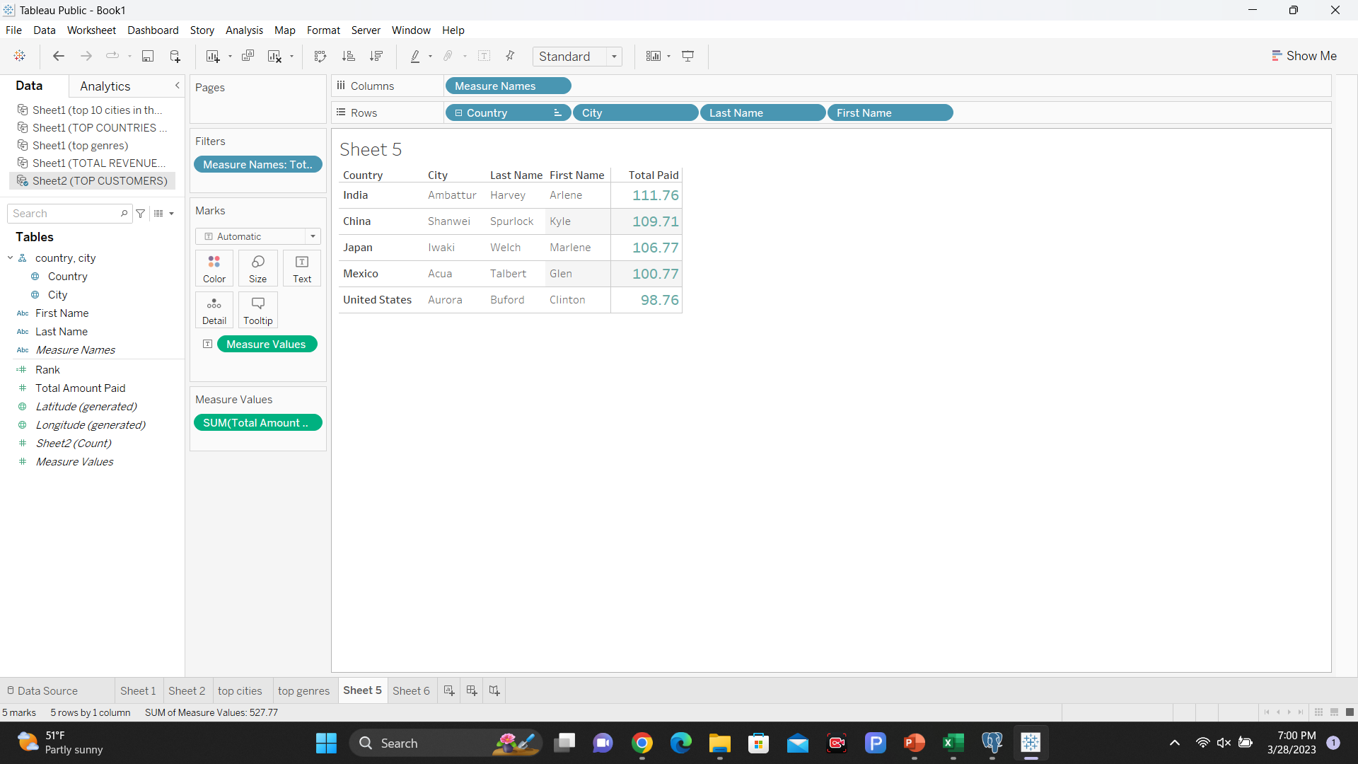
top 5 highest spending Customers
These 5 customers are Rockbuster's most loyal customers.
The client who spends the most is Arlene Harvey. She spent a total of $111.76.

Slide 8
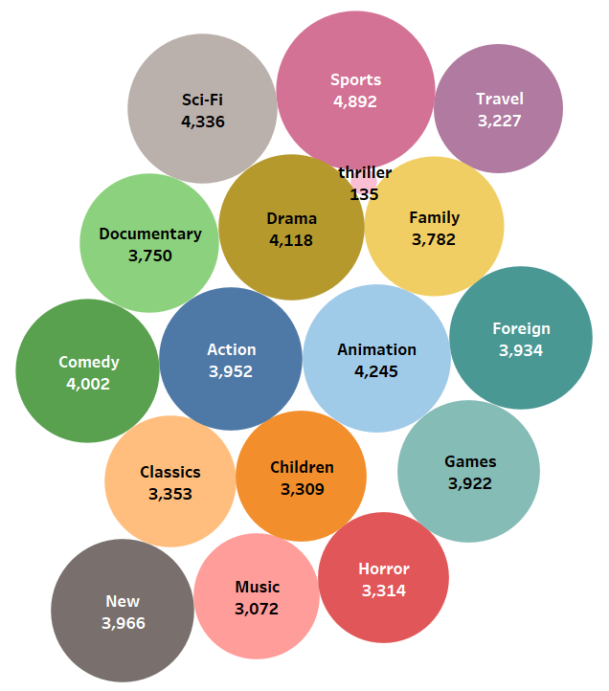
Which of Rockbuster’s Genres are most profitable?
Rockbuster's most profitable film genre is sports.It was the genre that generated the highest income $4,892k for the years 2005-2006.The lowest earning genre is Thriller with only $135k generated.

Slide 9
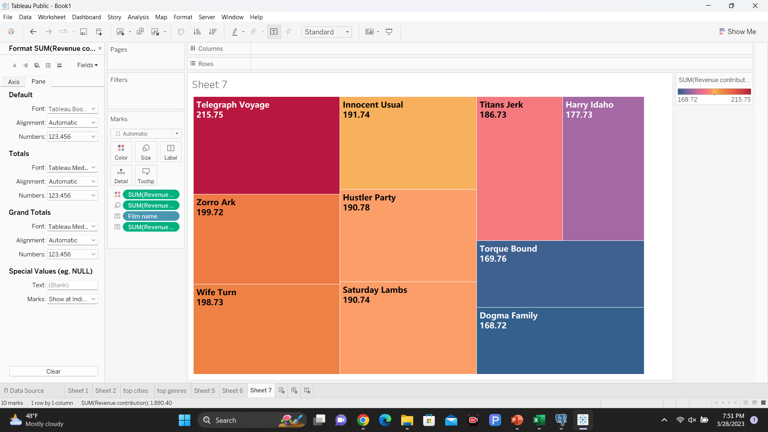
movies that contributed more in revenue
According to the results Telegraph Voyage and Zorro Ark were the highest grossing films with $215.75 and $199.72 respectively.

Slide 10



PROJECT SUMMARY
CUSTOMERS
GENRES
MOVIES
Revenue by genre shows that sports, sci-fi and animation films have larger shares of company revenue.
This information can be used in Rockbuster's selection report of movie titles to offer on its new online service.
Rockbuster customers have a preference for movies like Telegraph Voyage and Zorro Ark, which would be indicative of investing more in this type or genre of film, either in a more personalized type of marketing and promotions.
Most of the Rockbuster’s customers are in India and China, so marketing efforts and target points should be focused towards these regions.

Slide 11

CONCLUSIONS
The analysis according to the results obtained shows that Rockbuster Stealth should focus on the action of promoting the most profitable movie titles, in addition to focusing marketing on target markets such as India and China, since its client with the largest number of consumption are there. In addition, to prioritize its content oriented more towards sports, science fiction and animated films.
In the event that the company were to follow this line of decisions, it is very possible that it would retake its leadership in the video service market.

Slide 12
THANK YOU
MAGDA MERINO​
Rockbuster's presentation | Tableau Public

